Slide 1

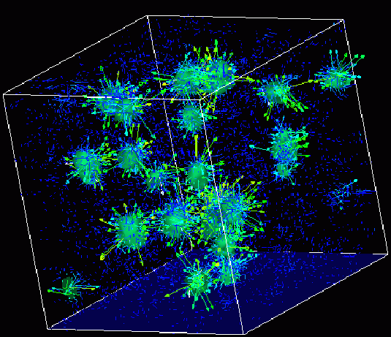
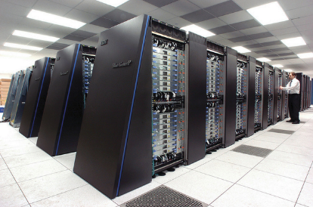
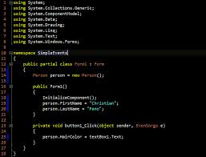
Survey of
Scientific Computing
(SciComp 301)
Dave Biersach
Brookhaven National Laboratory
dbiersach@bnl.gov
Session 22
Search Algorithms, Adjacency Matrix

Slide 2
Session Goals
Create a 2D maze on graph paper
Understand how to encode the cell walls in base 2
Learn how bitwise operators can decode a wall value
Perform file input / output using CSV and binary formats
Appreciate backtracking in depth-first search algorithm
Implement breadcrumbs using a stack data structure
Create an adjacency matrix to improve search efficiency

Slide 3
Maze Solver
Write a program to navigate maze of 10 x 10 square cells
The program must find a path from the entrance to the exit
The maze perimeter must not have any holes
There must not be any "one-way" doors
The program must run autonomously during the search
Each cell should be described using a simple encoding

Slide 4
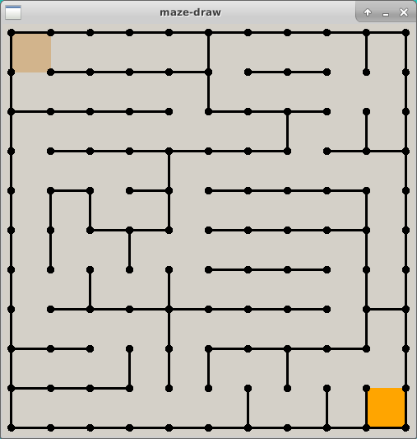
Entrance
This is a just a sample.
You will design and encode your own maze!
Exit

Slide 5
About C++ Arrays
Matrices are named first by row, then by column
A (3 x 2) matrix has 3 rows and 2 columns
In Cartesian coordinates
The abscissa X is listed first, followed by the ordinate Y: (X, Y)
Abscissa++ moves the world point right
Ordinate++ moves the world point up
In Array coordinates
The row is listed first, followed by the column: [Row] [Col]
Row++ moves downwards (inverted like screen coordinates!)
Col-- moves leftwards to the previous element in the current Row

Slide 6
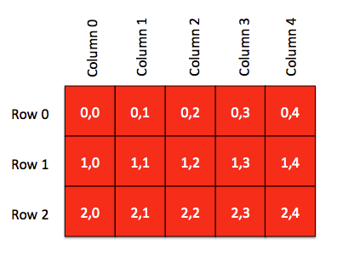
About C++ Arrays
C++ arrays are 0-based

Slide 7
0
1
2
3
4
5
6
7
8
9
0
Enter
10 Rows
10 Cols
Y = Rows
X = Cols
Positive Y is down!
Entrance = [0][0]
Exit
= [9][9]
1
2
3
4
5
6
7
8
9
Exit

Slide 8
How do we encode a maze?
Encode each wall position as an increasing power of 2
Consider how to describe each individual square (cell) within the maze
How can we indicate for each individual cell if a wall exists to the North, East, South, or West direction?
North = 1
West = 8
East = 2
South = 4

Slide 9
How do we encode a maze?
If a wall exists in a given direction, add the value of that direction to the total cell value
North = 1
9
West = 8
East = 2
South = 4

Slide 10
How do we encode a maze?
Using a power of 2 for each wall value produces an unambiguous encoding of all wall permutations
0 ≤ cell value ≤ 15
No walls = zero (0)
15 = a totally “walled-in” cell that is unreachable (Hint: don’t make a cell = 15)
North = 1
7
West = 8
East = 2
South = 4

Slide 11
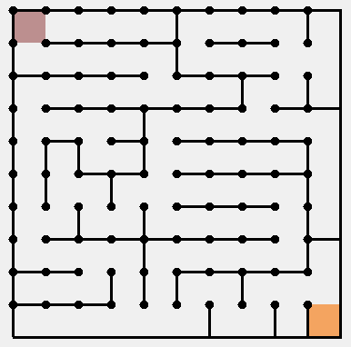
0
1
2
3
4
5
6
7
8
9
0
1
2
3
4
5
6
7
8
9

Slide 12
0
1
2
3
4
5
6
7
8
9
0
9
5
5
5
7
9
5
5
3
11
1
12
5
5
5
3
12
5
5
0
2
2
9
5
5
5
4
5
7
9
6
14
3
8
5
1
7
9
5
5
4
5
3
4
10
11
12
7
8
5
5
5
7
10
5
10
8
3
9
0
5
5
5
3
10
6
8
6
12
6
12
5
5
5
2
14
7
12
5
1
3
9
5
5
5
6
11
8
13
5
6
10
10
9
3
9
1
2
9
13
5
5
4
4
6
12
6
14
14

Slide 13
Drawing the 2D Maze
Given a maze initialized with Base 2 wall encodings, how can we draw it?
We could use a long series of if() statements to test all 16 possible values for a cell, and draw the required walls
However, this would be inefficient in code size and run time
We can take advantage of bitwise AND to figure out what walls to draw for a given cell

Slide 14
Bitwise Operators
Logical operators use double ampersand or pipe characters
Boolean X and Y conditions: if (X && Y)
Boolean X or Y conditions: if (X || Y)
Bitwise operators use single ampersand or pipe character
Bitwise X and Y values: X & Y
Bitwise X or Y values: X | Y
Logical operators only return true or false
Bitwise operators return a integer value
You normally only perform bitwise operations on integers

Slide 15
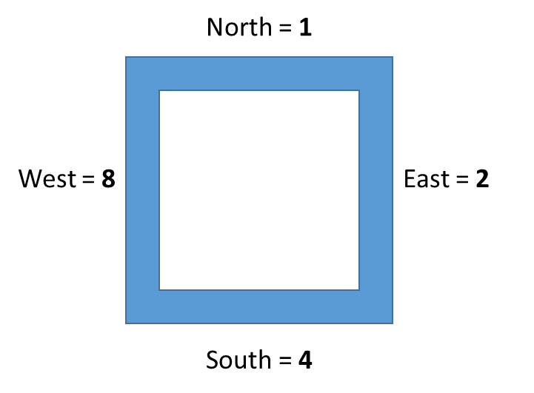
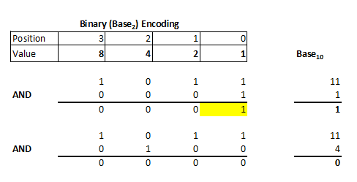
Bitwise AND
11

Slide 16
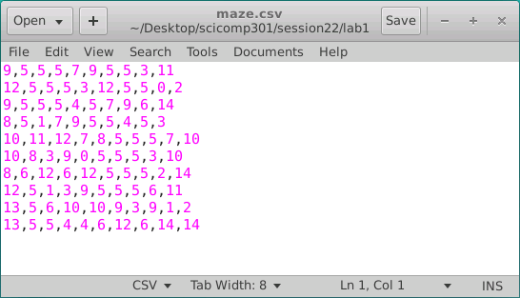
Encoding the Maze walls
CSV = Comma Separated Values
A “formatted” text file

Slide 17
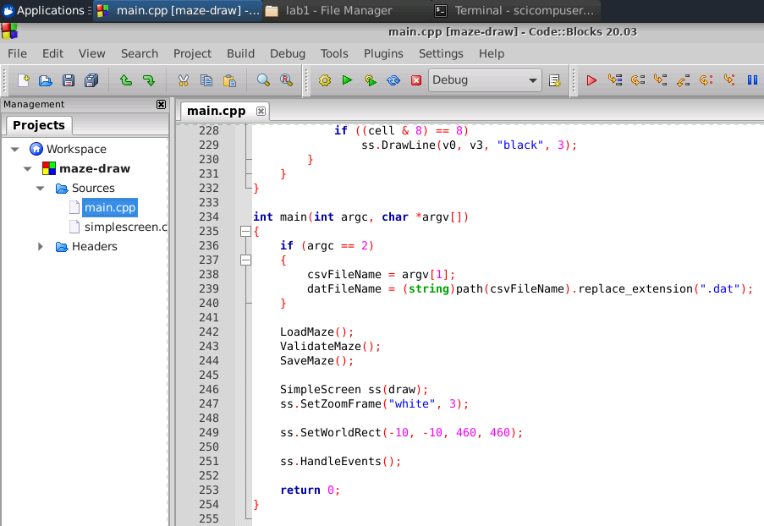
Open Lab 1 – Maze Draw

Slide 18
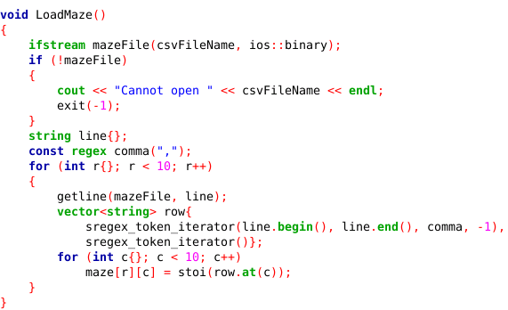


Reading data in TEXT format (CSV)
input file stream
string to integer
0 1 2 3 4 5 6 7 8 9
0
1
2

Slide 19
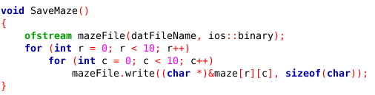
Writing data in BINARY format (DAT)
output file stream
maze.csv
Lab 1
maze.dat

Slide 20
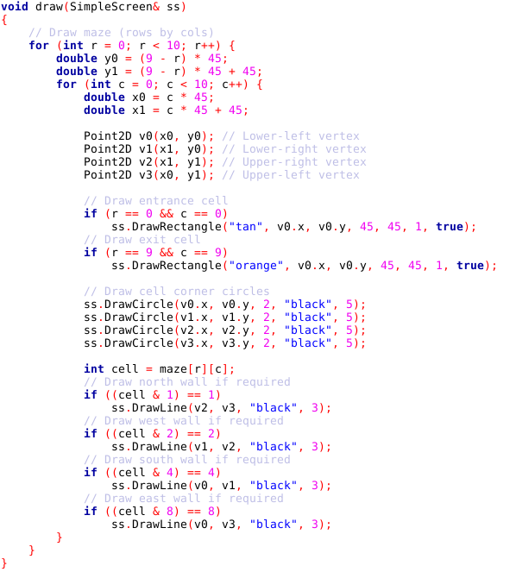
Lab 1 Maze Draw
North = 1
❸
❷
West = 8
East = 2
⓿
❶
South = 4

Slide 21
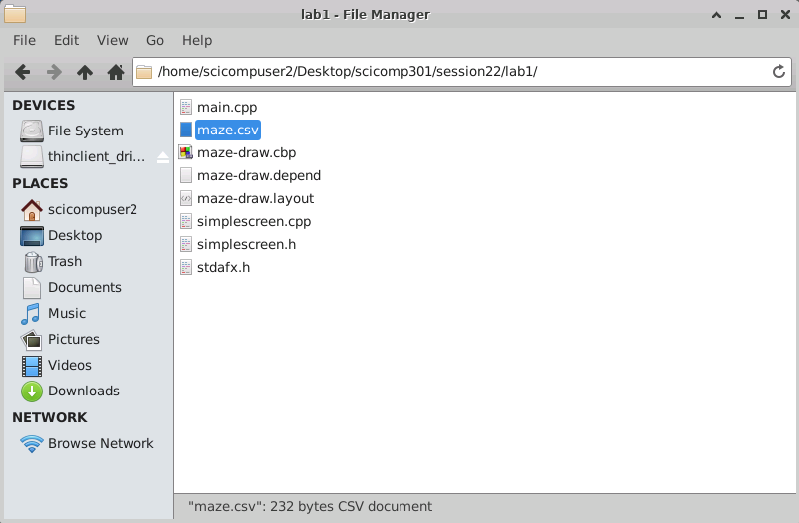
Encoding the Maze walls
Double click on the maze.csv file

Slide 22
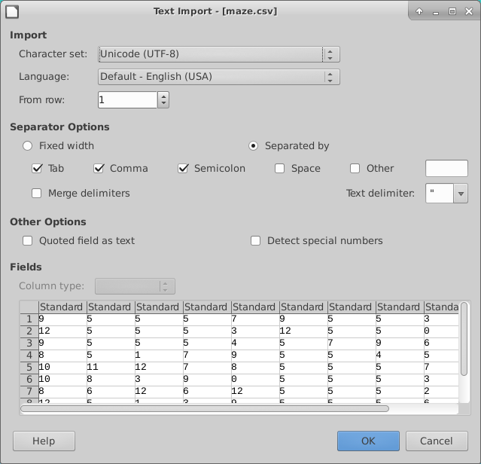
Encoding the Maze walls

Slide 23
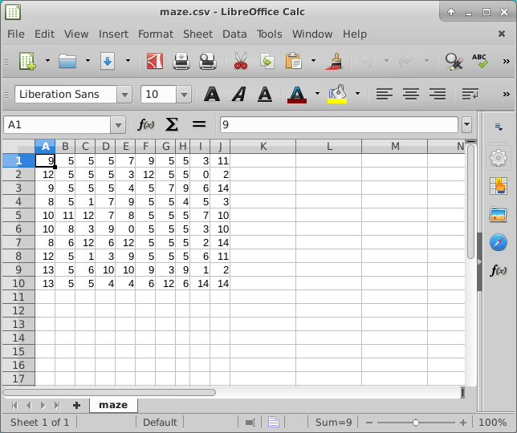
Encoding the Maze walls
Ensure you maintain a
10 x 10 matrix
as you enter your own maze cell values

Slide 24
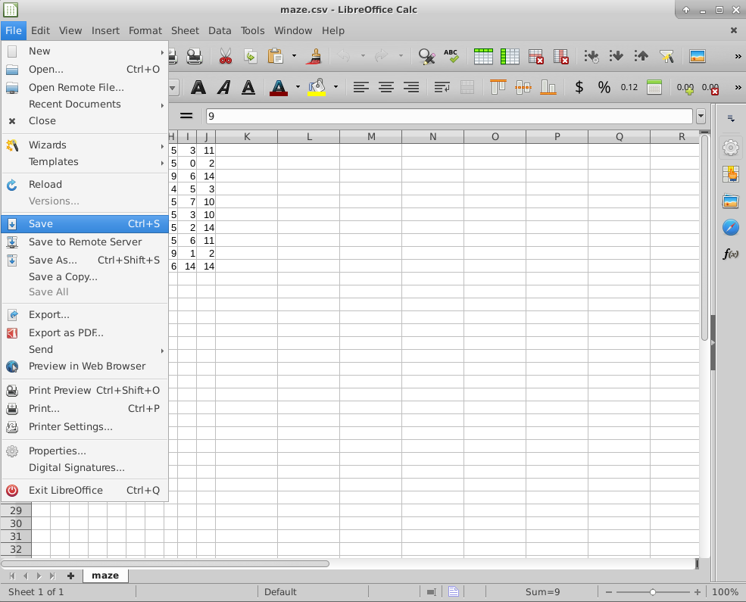
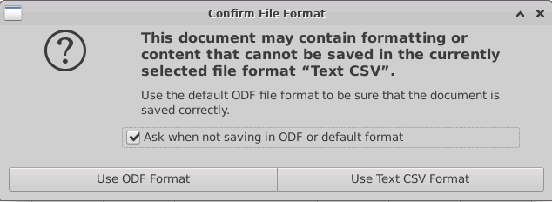
Encoding the Maze walls
Be sure to SAVE your maze file!

Slide 25
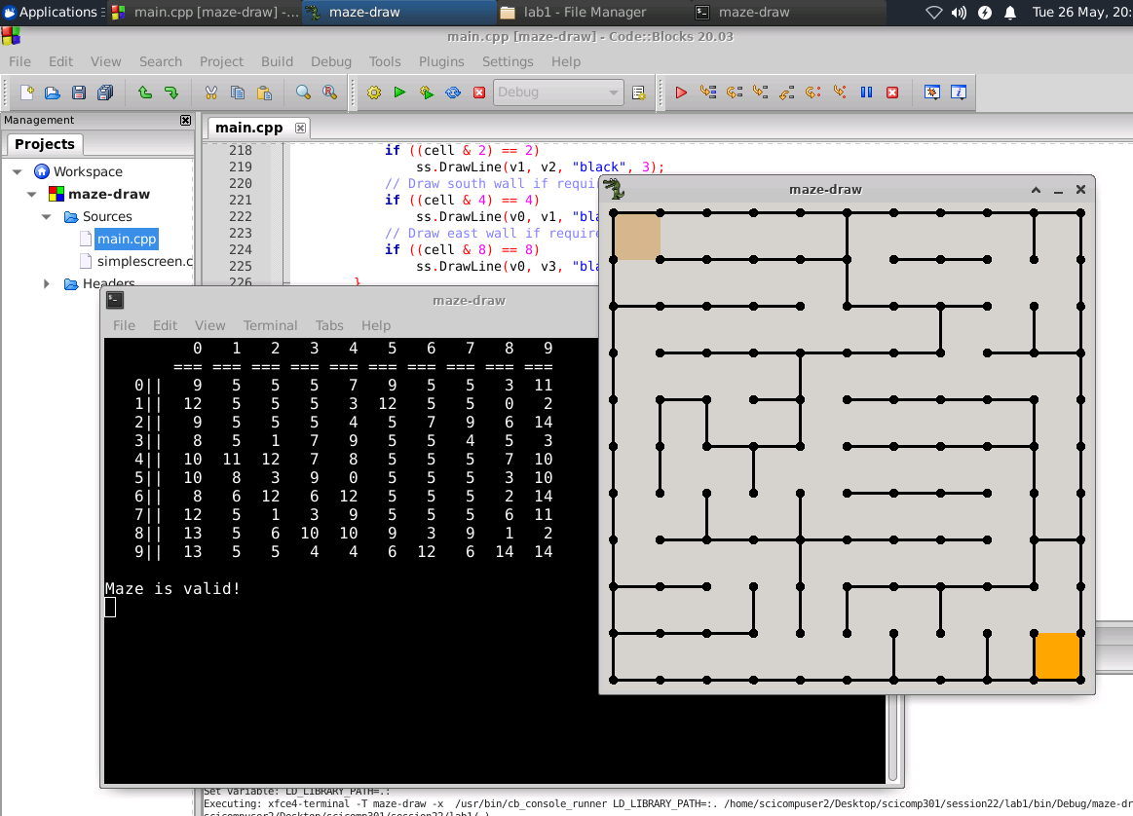
Run Lab 1 – Maze Draw

Slide 26
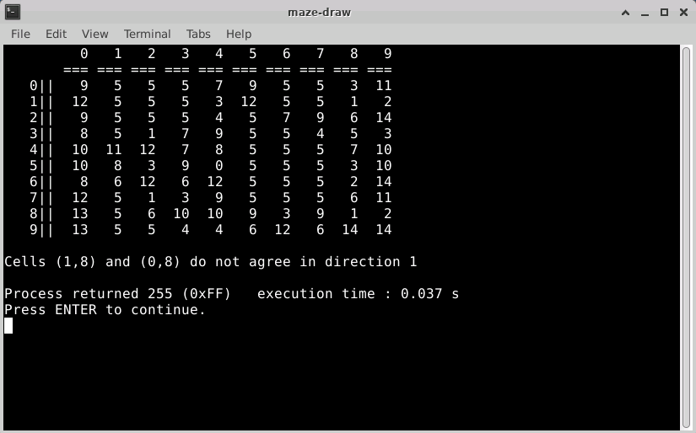
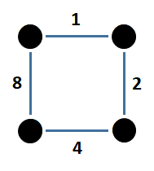
Lab 1 – Maze Draw
Adjacent cells must agree on their wall values

Slide 27
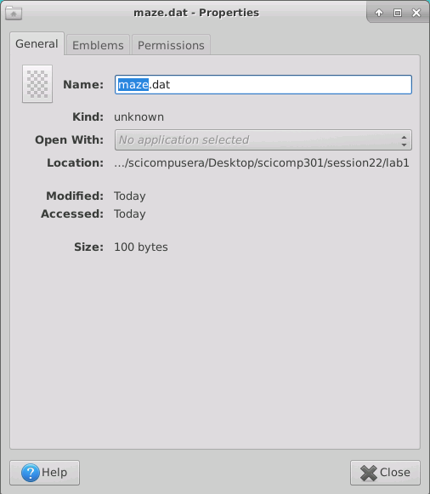
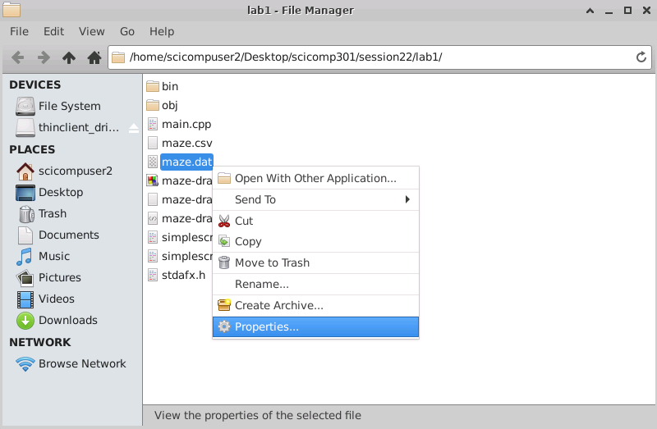
Lab 1 – Binary Output File
Right click on maze.dat and then select “Properties”
One byte for each cell in your
10 x 10 maze!

Slide 28
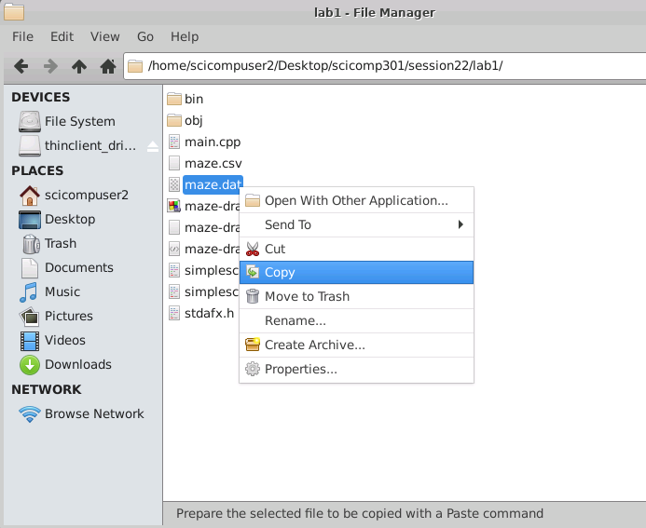
Lab 1 – Binary Output File
You must copy your maze.dat file to the lab2 and lab3 folders!

Slide 29
Depth-First Search
Depth-first is a sequential search algorithm
It is just you alone in the maze, you have no helpers
It is a zero prior knowledge, recursive, backtracking approach
You have breadcrumbs to mark your cell visitation history
Order of search in each cell is North, East, South, West
We can only proceed in a direction if there is no wall in the path:
if (cell value & direction) != direction
North (1) → (Δ row = -1, Δ column = 0)
East (2) → (Δ row = 0, Δ column = 1)
South (4) → (Δ row = 1, Δ column = 0)
West (8) → (Δ row = 0, Δ column = -1)

Slide 30
Depth-First Search Algorithm
Drop a breadcrumb as you enter each cell
Take a step in the very first direction that is open, and go to step #1
If there are no more open directions in the cell, retrace your steps backwards until you reach a cell with a breadcrumb where the next open direction is one you have not taken yet
Take a step in that new direction, and go to step #1
Stop with you reach the exit square

Slide 31
Depth-First Search Breadcrumbs
A breadcrumb matrix (array) can contain a simple bool value to indicate if you have previously visited this cell
Breadcrumbs prevent going around in endless circles and never finding the exit
In this program we use an int visitCount array, so we can color the path according to the number of times we’ve visited each cell (1=Blue, 2=Green, 3=Red, 4=Orange)
Lots of red and orange squares in the path indicates an inefficient search pattern, because you are visiting the same node too many times!

Slide 32
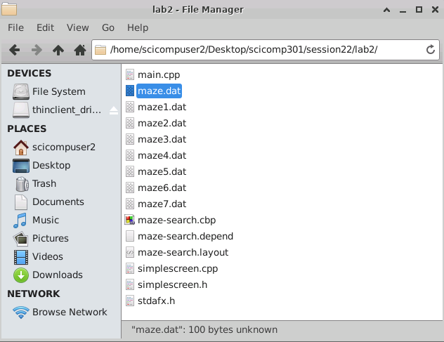
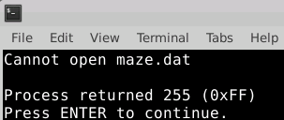
Lab 2 – Maze Search
Make sure you have copied
your maze.dat
(which was created by Lab 1)
into this Lab 2 folder

Slide 33
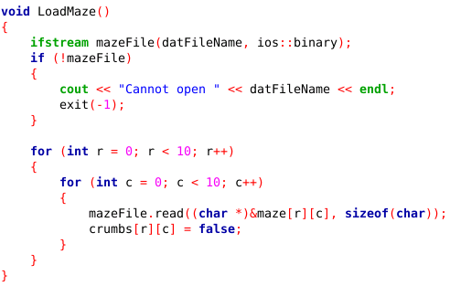
Lab 2 – Maze Search
Lab2 reads in the binary file maze.dat

Slide 34
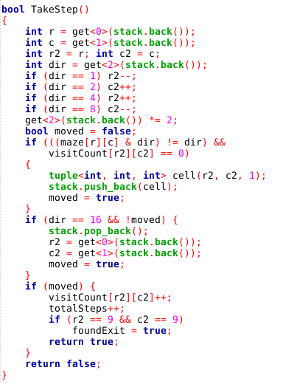
Lab 2 Maze Search
The program tries to take a step in each direction, updating the visitCount array with each step

Slide 35
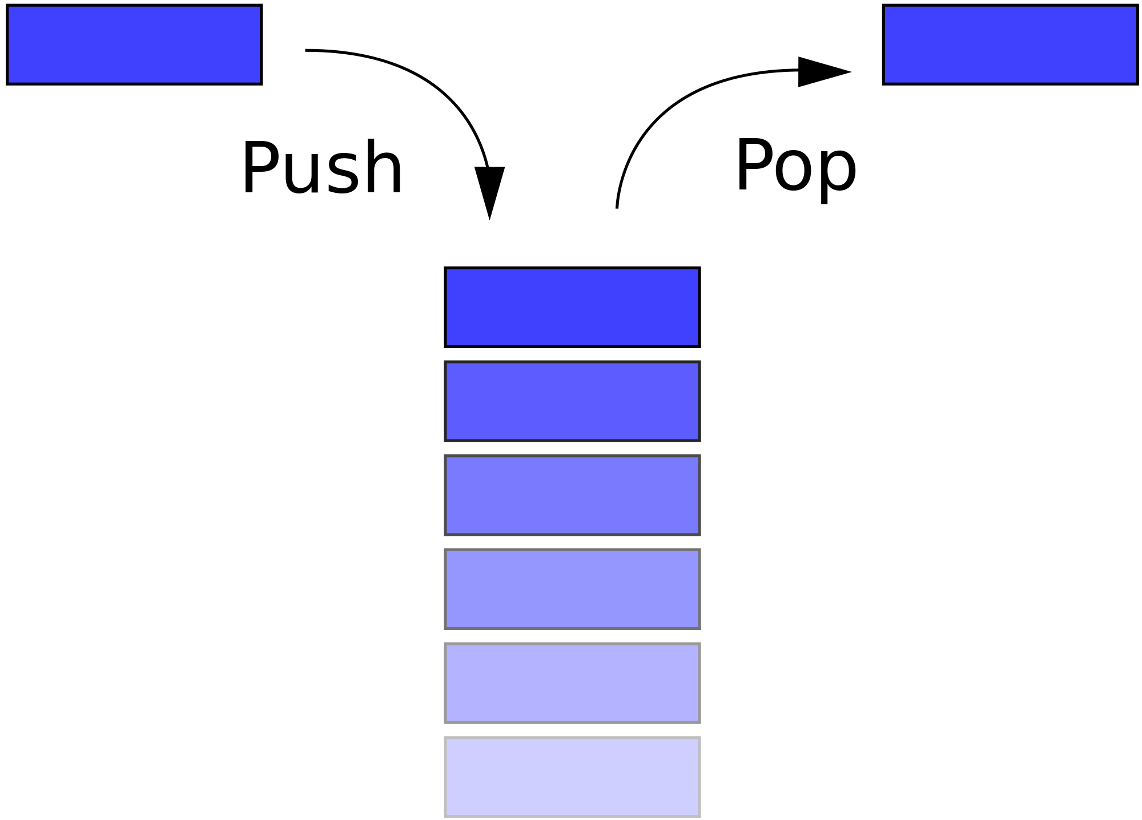
Lab 2 – Maze Draw
Entrance
We use a “stack” data structure to record the [row][col] of the navigator at each step through the maze

Slide 36
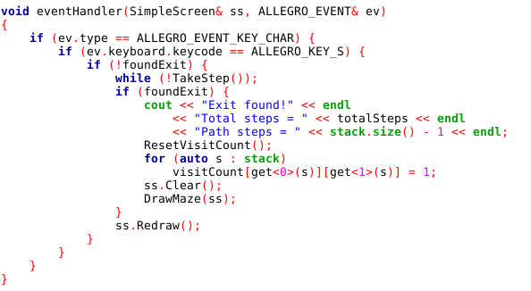
Lab 2 – Maze Search
Press S to take a single step
When the exit is found,
your path will be shown
(after removing any backup steps)

Slide 37
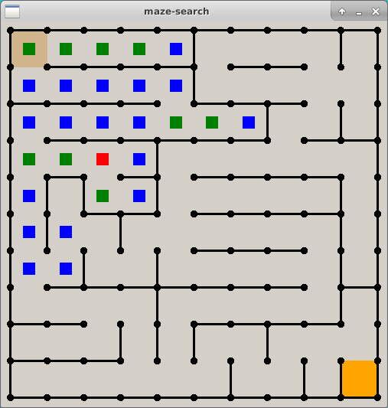
Lab 2 – Maze Search
Colors indicate the number of times a square (cell) was revisited due to backing up from dead ends or breadcrumbs
Press S to take a single step
Press F to full step to finish

Slide 38
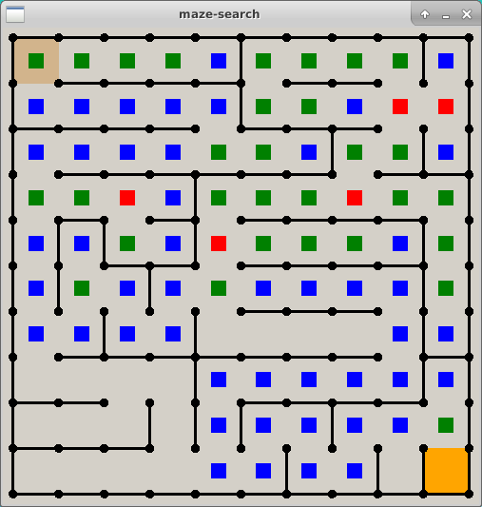
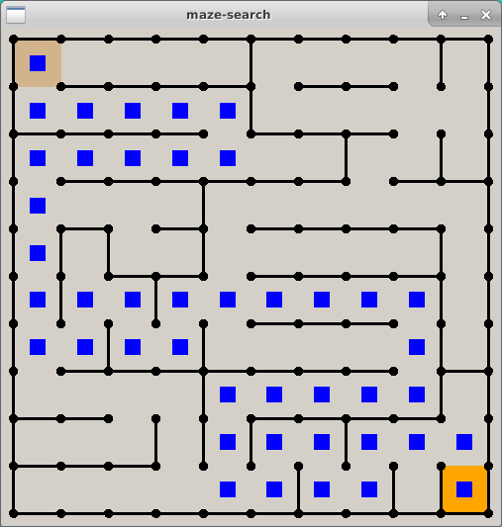
Lab 2 – Maze Search
Right before stepping into exit cell
Right after stepping into exit cell
When the exit is found, your path will be shown
(after removing any backup steps)

Slide 39
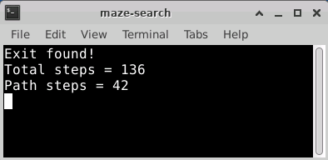
Lab 2 – Maze Search
Right after stepping into exit cell
Total steps = How many you had to take counting backup steps
Path steps = The best path you found minus any backup steps
When the exit is found, your path will be shown
(after removing any backup steps)

Slide 40
Improving Depth-First Search Efficiency
The unaided depth-first search spends considerable time exploring paths which clearly are not on the optimal route – it hits a lot of dead ends
What if we could calculate the shortest path length, and start backtracking the instant our current path length ≥ the shortest path length?
It is possible to calculate the minimum number of steps from entrance to exit (the shortest path) without searching one cell or taking one step!

Slide 41
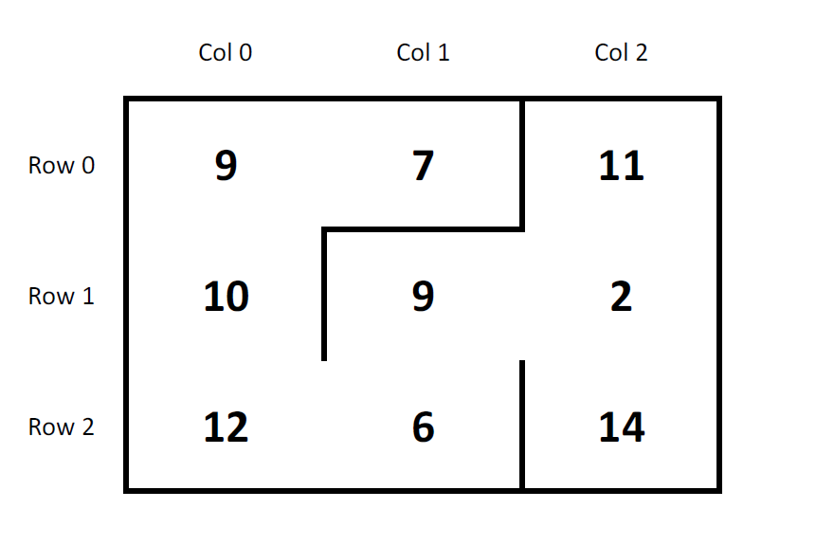
Adjacency Matrix
3 x 3 maze
9 total cells

Slide 42
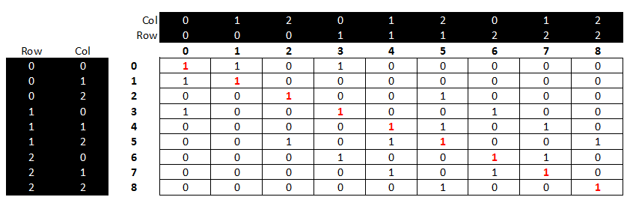
Adjacency Matrix
Every maze square (cell) is represented along both
the rows and columns of an adjacency matrix
A true (1) indicates you can reach the other cell in just one step
A false (0) means that you cannot reach the other cell in just one step

Slide 43
Adjacency Matrix
The main diagonal has all one values
because every cell can reach itself by definition
The whole matrix is symmetric about the main diagonal
because there are no “one-way” doors in the maze.
Reflexive Property: If you can get from cell A to cell B in one step,
then you can also get from cell B to cell A in one step

Slide 44
Adjacency Matrix
To find the shortest path, we keep ANDing (using the logical operator &&) the adjacency matrix against itself until a true value appears in the matrix element that represents the exit cell
The number of times we had to “multiply” (AND) the adjacency matrix by itself equals the minimal # of steps from entrance to exit
Ironically, we can know the # of steps in the shortest path, but not what the actual steps are!

Slide 45
Adjacency Matrix
If it is true you can get from A to B, and it is true you can get from B to C, then it must be true that you can get from A to C (transitive property)
When “multiplying” bool adjacency matrices, if the AND of all the elements in (Row A x Col B) == true then the cell is set to true
We keep multiplying the adjacency matrix until a true appears in the cell that represents the exit square.
The total # of matrix multiplications required = the shortest path length from entrance to exit

Slide 46
Adjacency Matrix
We can calculate the adjacency matrix before starting a depth-first search. We can then use this shortest path length to limit the current search path to improve the efficiency of the search
Once the current stack.size() has more levels than the shortest path length calculated from the adjacency matrix, start back tracking!
There is no reason to continue on a path which has a step count greater than the known shortest path – it’s best to backup and try a new direction

Slide 47
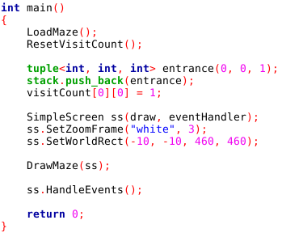
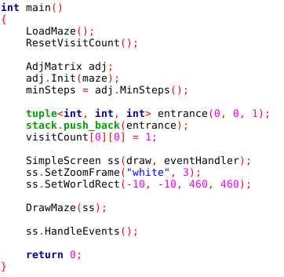
Lab 3 – Maze Search
Lab 2 – Maze Search w/o Adj Matrix
Lab 3 – Maze Search w Adj Matrix
The variable minSteps holds the # of steps in the shortest path from entrance to exit

Slide 48
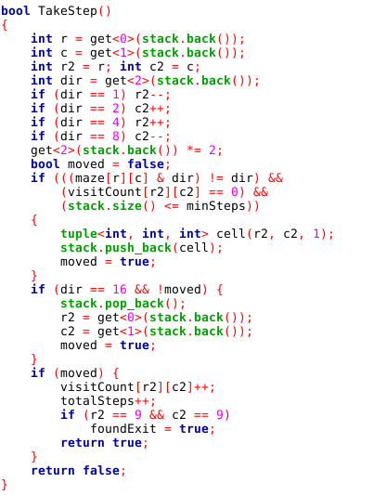
Lab 3 – Maze Search
Lab 2 – Maze Search w/o Adj Matrix
Lab 3 – Maze Search w Adj Matrix

Slide 49
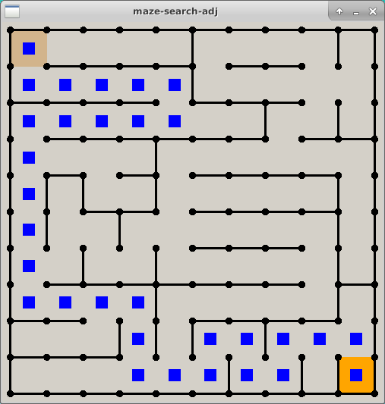
Lab 3 – Maze Search
Lab 2 – Maze Search w/o Adj Matrix
Lab 3 – Maze Search with Adj Matrix
Path Steps = 42
Path Steps = 30

Slide 50
Lab 3 – Maze Search
On average using an adjacency matrix reduces the steps in a depth-first search by 25%

Slide 51
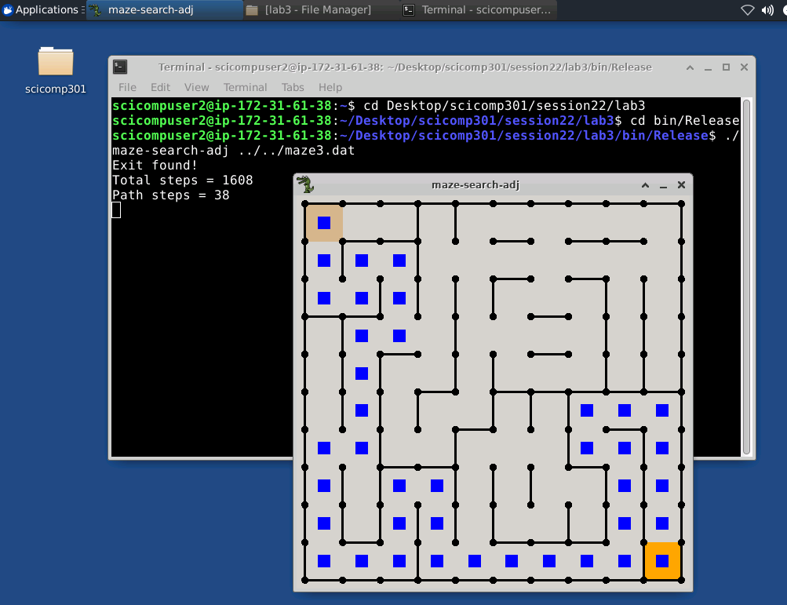
Lab 3 – Maze Search
cd Desktop/scicomp301/session22/lab3
cd bin/Release
./maze-search-adj ../../maze3.dat

Slide 52
Now you know…
How to encode 2D maze walls in base 2
In C++ an [Y][X] matrix means there are Y rows and X columns
The bitwise AND (&) operator can decode wall values
Depth-first search is implemented with recursion or a stack
You must use a breadcrumbs array to prevent infinite loops
A logical adjacency matrix can be used to calculate the length of the shortest path from entrance to exit
However, the adjacency matrix will not identify the actual steps along that shortest path
Leveraging the adjacency matrix during a depth-first search will yield on average a 25% improvement in the efficiency of the search

